Slide 1
HOW GREEN IS SINGAPORE?
Transport Edition -
By Ashley Bai (P2237871)

Slide 2
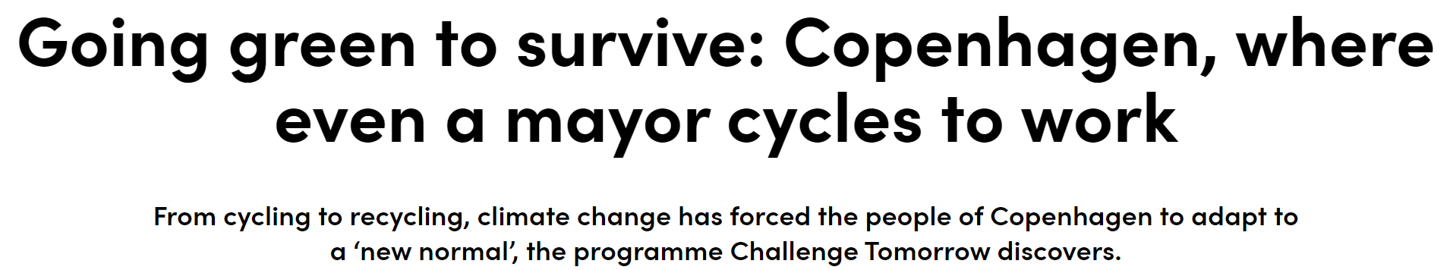
Source: https://www.channelnewsasia.com/world/going-green-survive-copenhagen-where-even-mayor-cycles-work-1021146

Slide 3
Like the Danish, has Singaporeans helped to reduce global warming by making better transport choices?
Do Singaporeans choose to take public over private transport?
How has accessibility (no. of facilities) influence people’s transport choices?
Has Singapore made public transport more accessible?
Has Singaporeans choose to buy eco-friendly cars instead of fuel-run cars?

Slide 4
URL of Datasets
01
02
03
04
Ridership
MRT & LRT stations
Commuter facilities
Green vehicles
https://data.gov.sg/dataset/public-transport-utilisation-average-public-transport-ridership
https://data.gov.sg/dataset/number-of-mrt-lrt-stations
https://data.gov.sg/dataset/commuter-facilities
https://data.gov.sg/dataset/climate-change-and-energy-green-vehicles

Slide 5
01
NATURE OF DATASETS
Before Cleaning

Slide 6
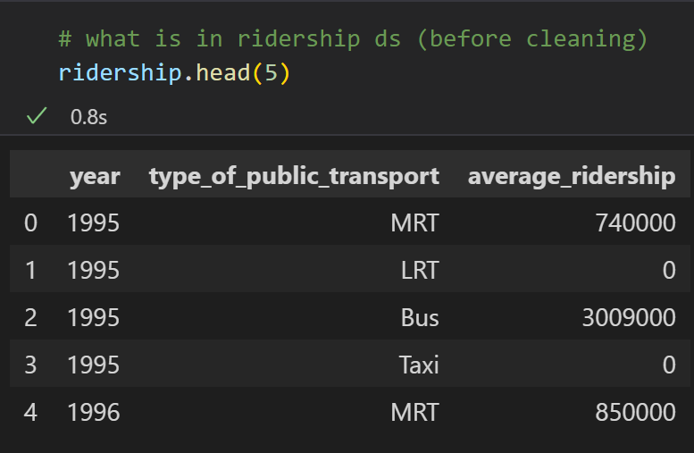
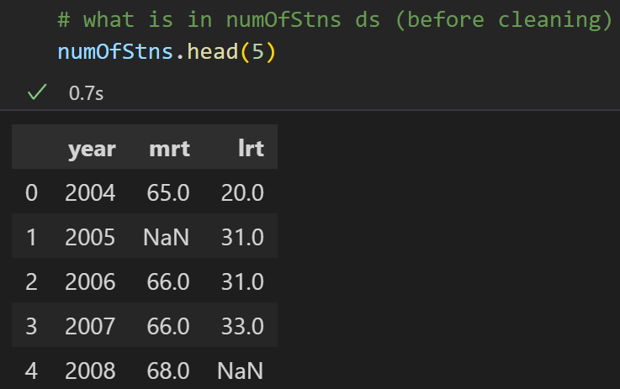
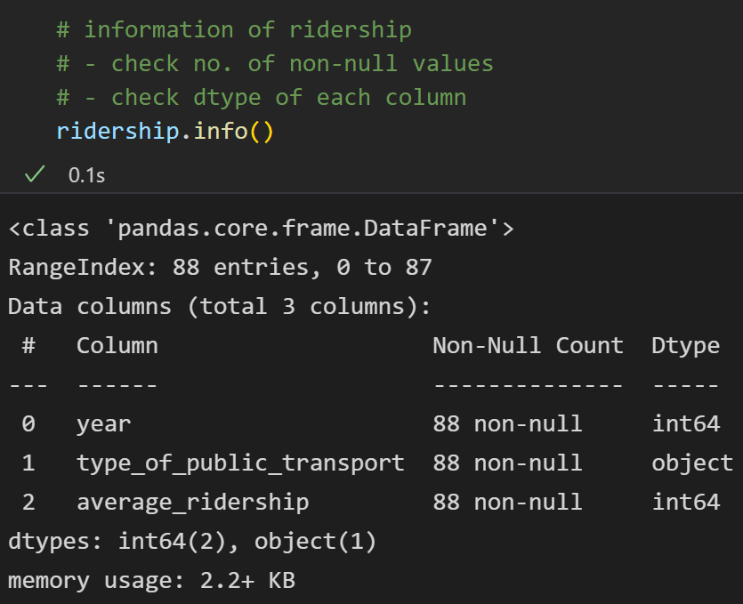
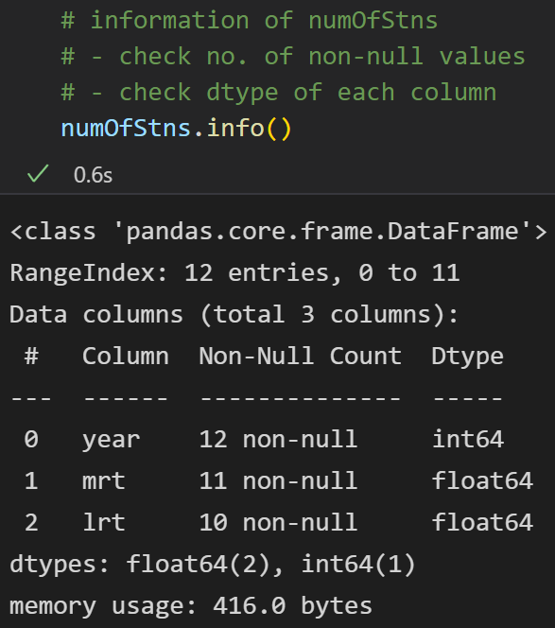
1 RIDERSHIP
2 NUMOFSTNS
Contains quantitative & qualitative data
Contains quantitative data
No null values/missing values,
data includes integer/string dtypes
3 missing/null values,
data includes integer/float dtypes

Slide 7
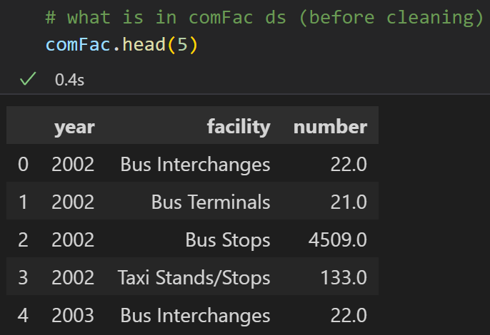
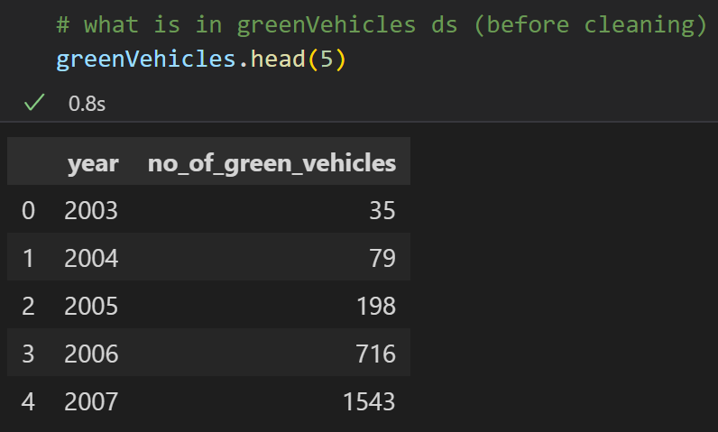
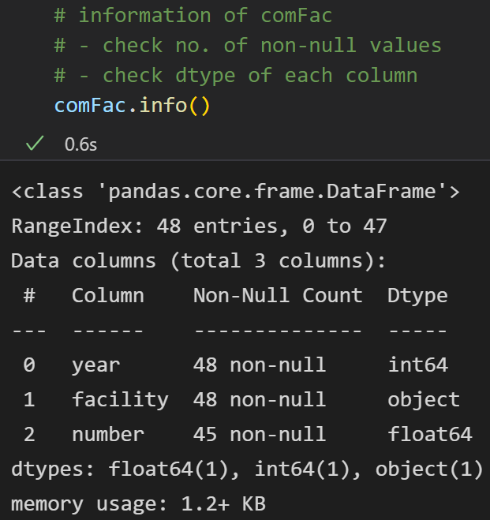
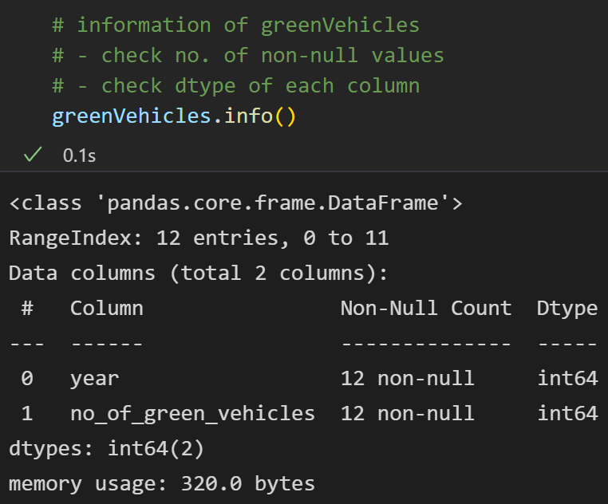
3 COMFAC
4 GREEN VEHICLES
Contains quantitative & qualitative data
Contains quantitative data
3 null values/missing values,
data includes integer/string/float dtypes
No missing/null values,
data includes integer dtypes

Slide 8
02
CLEANING OF DATASETS

Slide 9
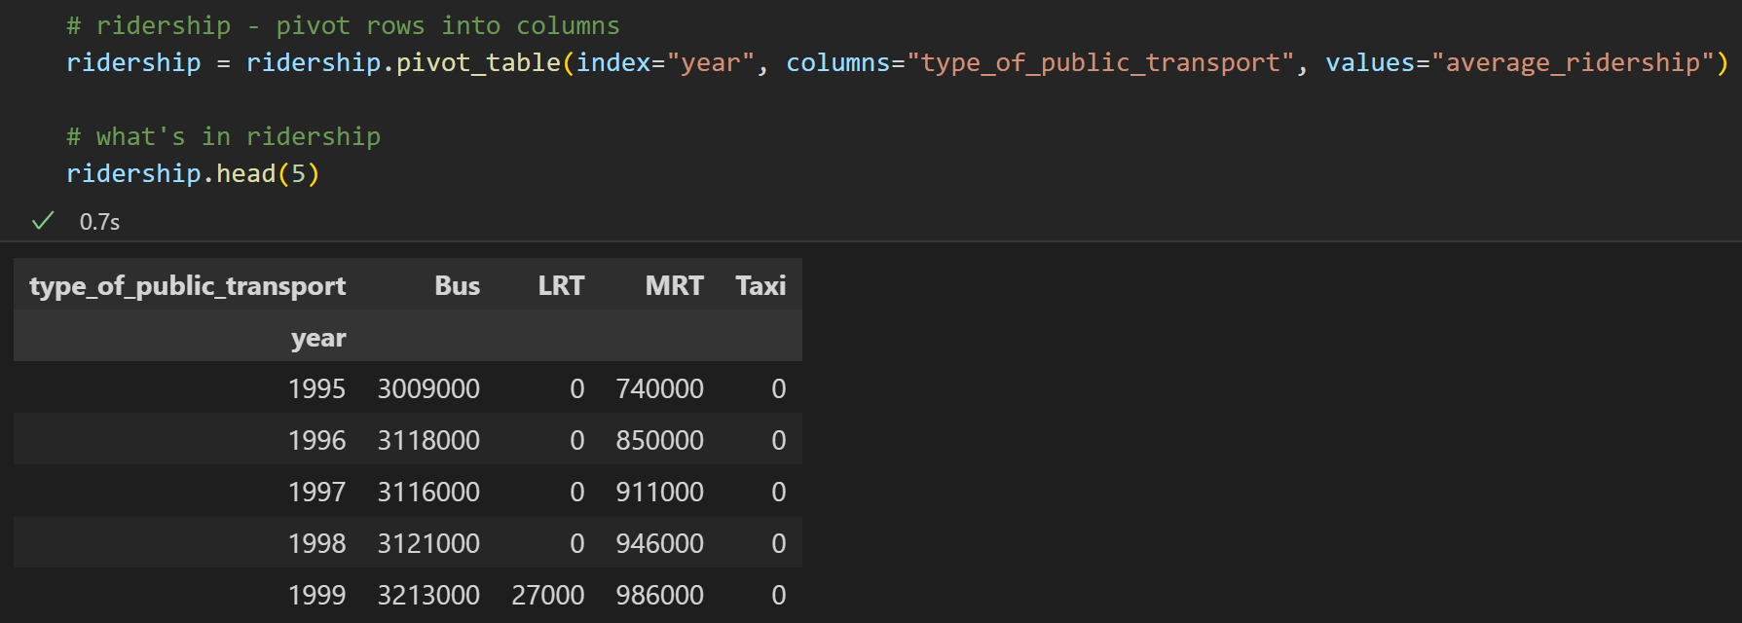
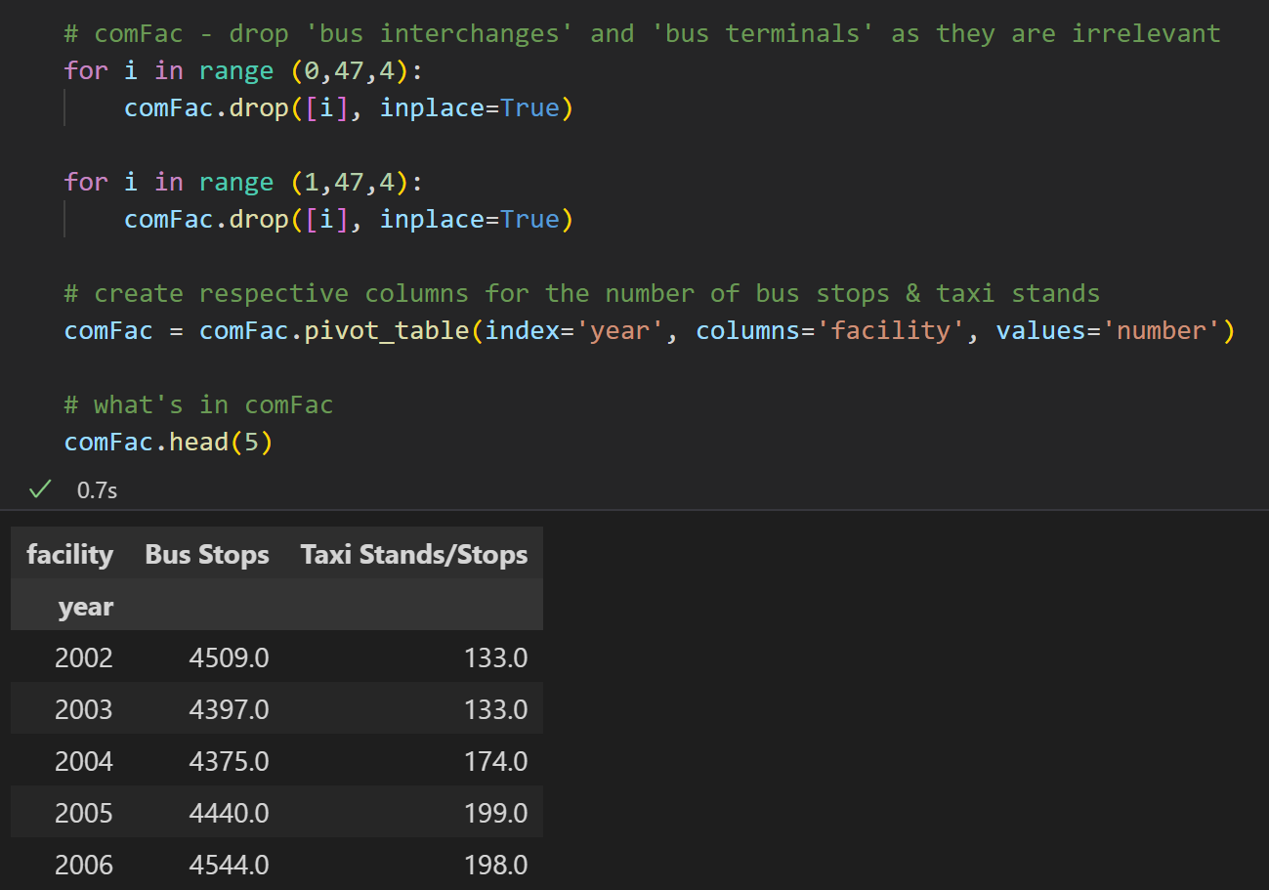
MERGING INTO ONE DF
1) I pivoted rows in ridership to columns to help in the merging process.
2) Then, I dropped rows that were not = Bus Stops/Taxi Stands as they were not relevant to my analysis. Thereafter, I pivoted the rows in comFac to columns to help in the merging process.

Slide 10
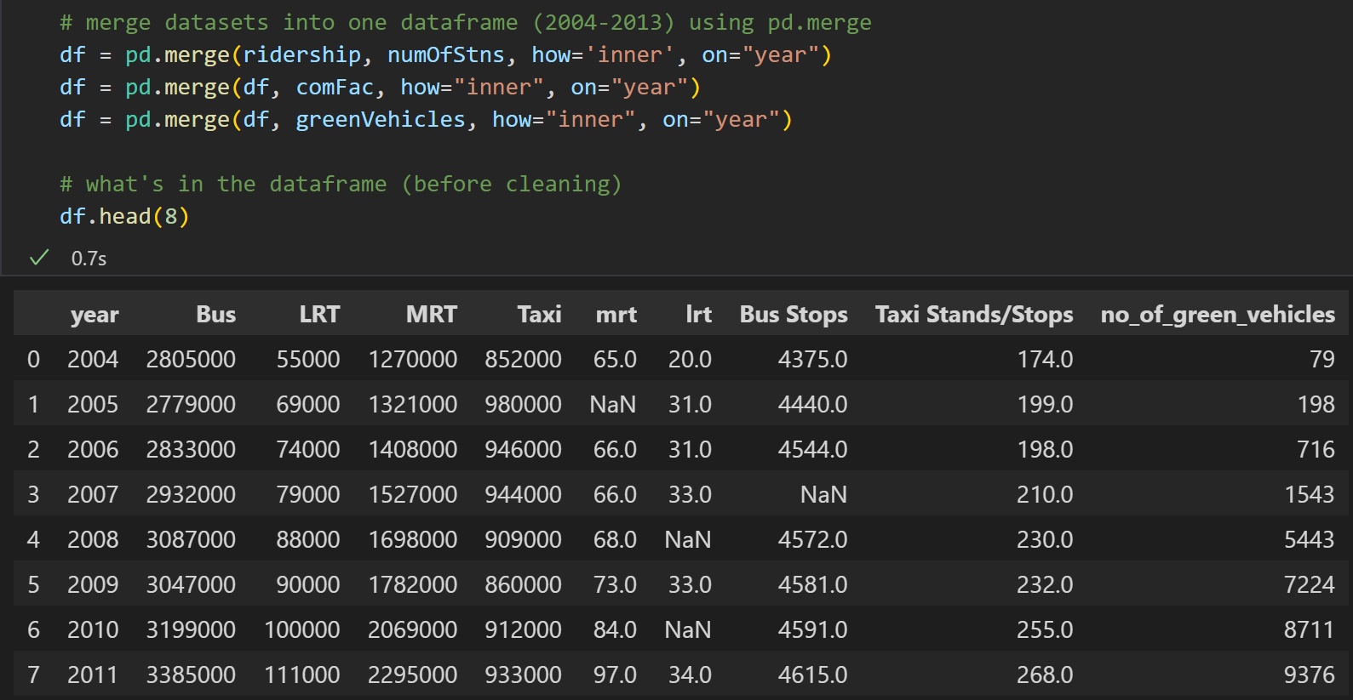
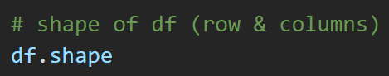
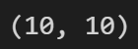
MERGING INTO ONE DF
Lastly, I merged all the datasets into one dataframe using pd.merge where I joined them by a common factor, ‘year’.
This dataframe now only covers the years 2004 to 2013.

Slide 11
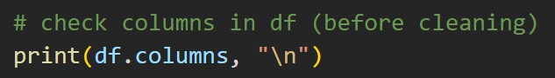
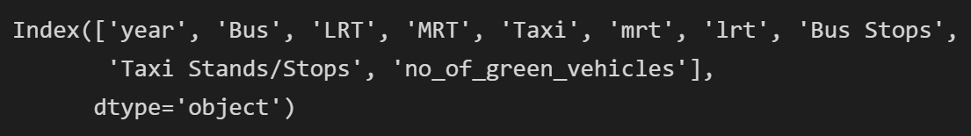
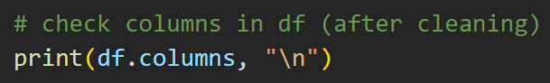
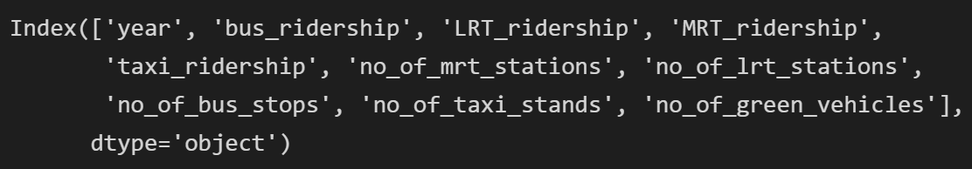
CHECKING COLUMNS IN DF
I renamed the columns for easier identification.

Slide 12
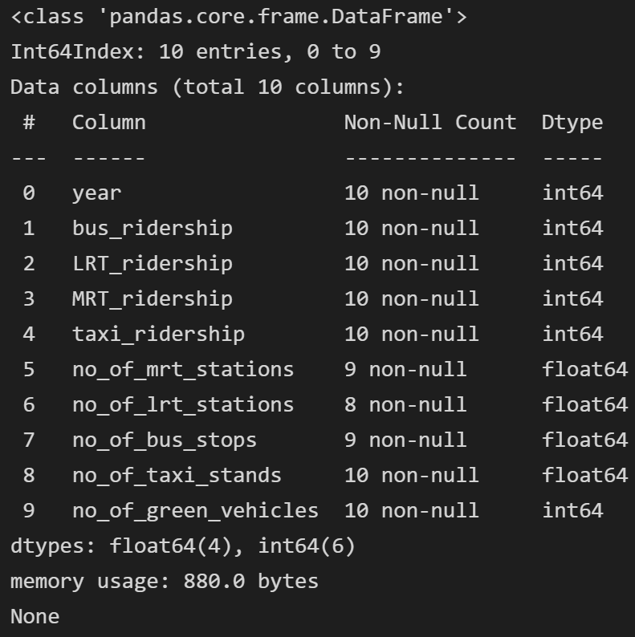
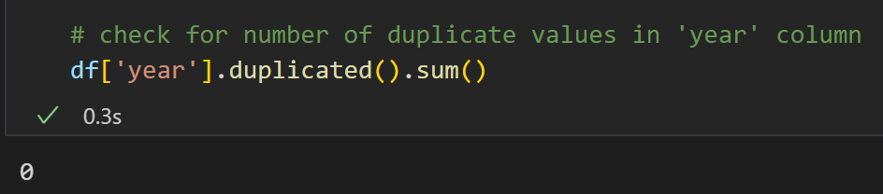
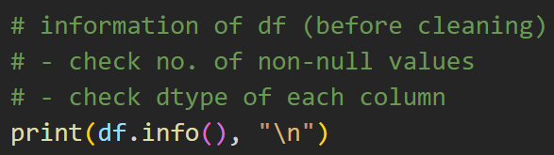
INFORMATION OF DF

Slide 13
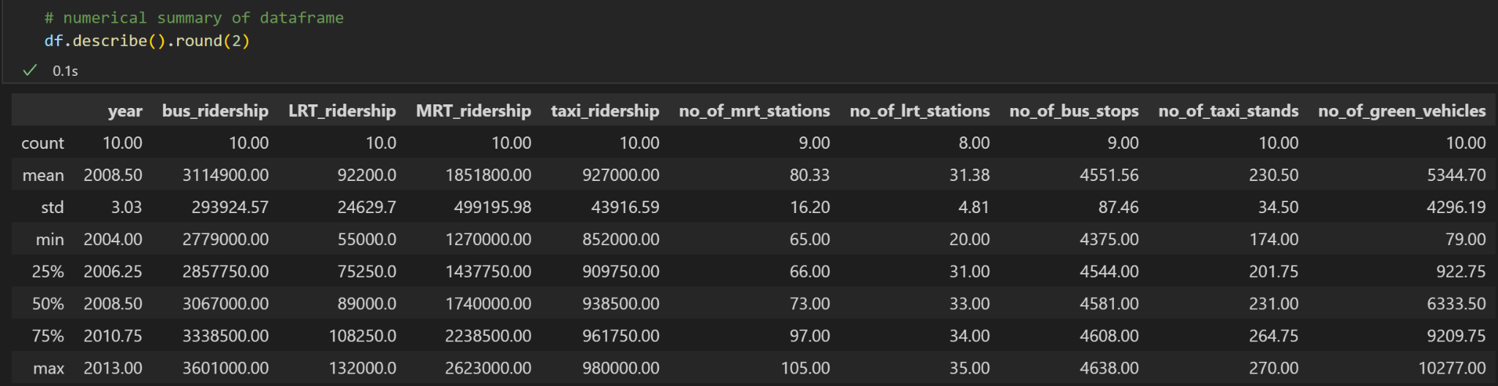
NUMERICAL SUMMARY OF DF

Slide 14
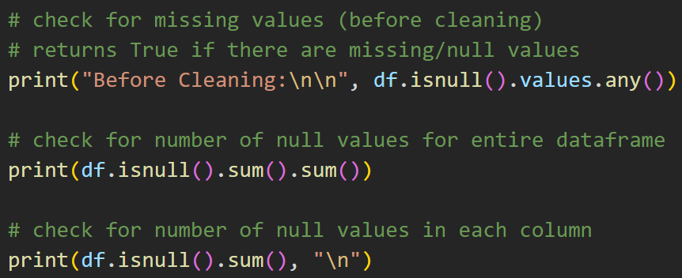
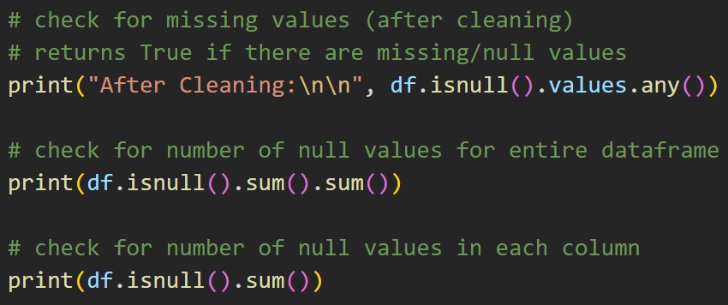
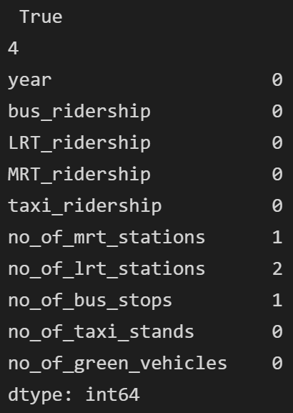
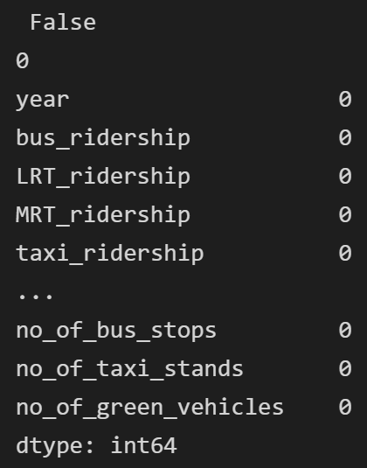
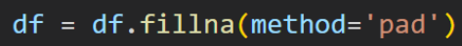
Identify & Handle Missing Values
Before:
After:
I handled missing values by filling the gaps in the columns forward.

Slide 15
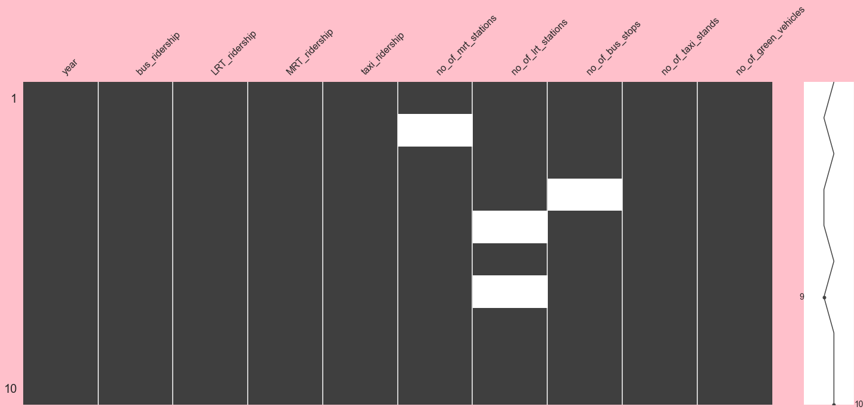
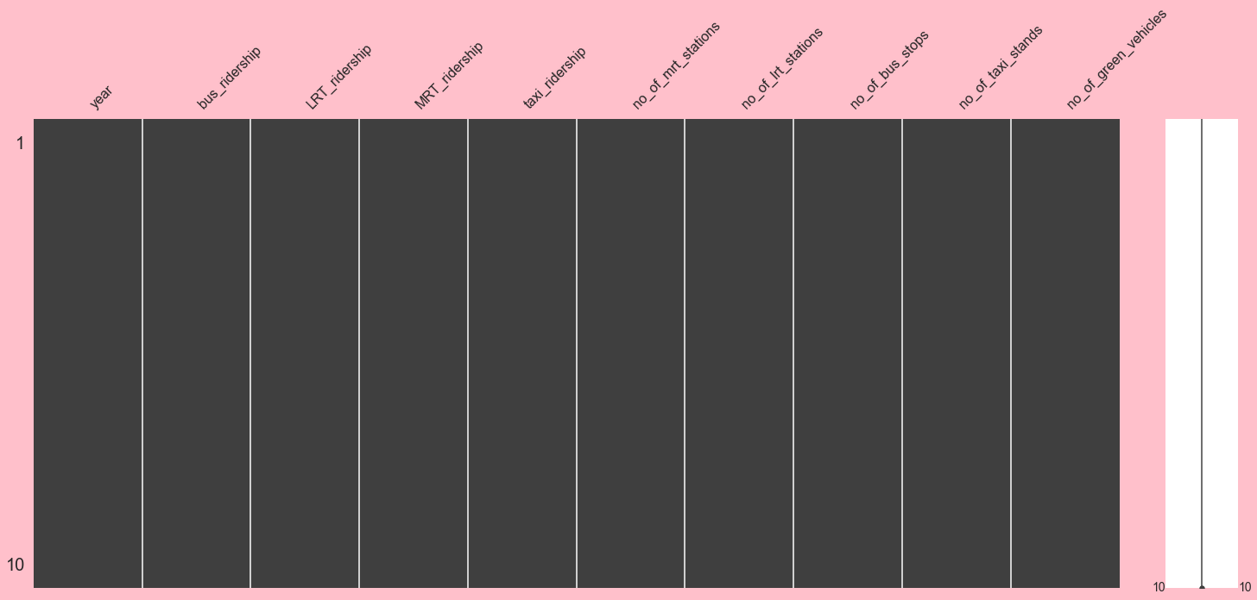
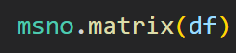
Visualisation of Missing Values
Before:
After:
I plotting a matrix with missingno, the white spaces in the matrix represents missing/null values.

Slide 16
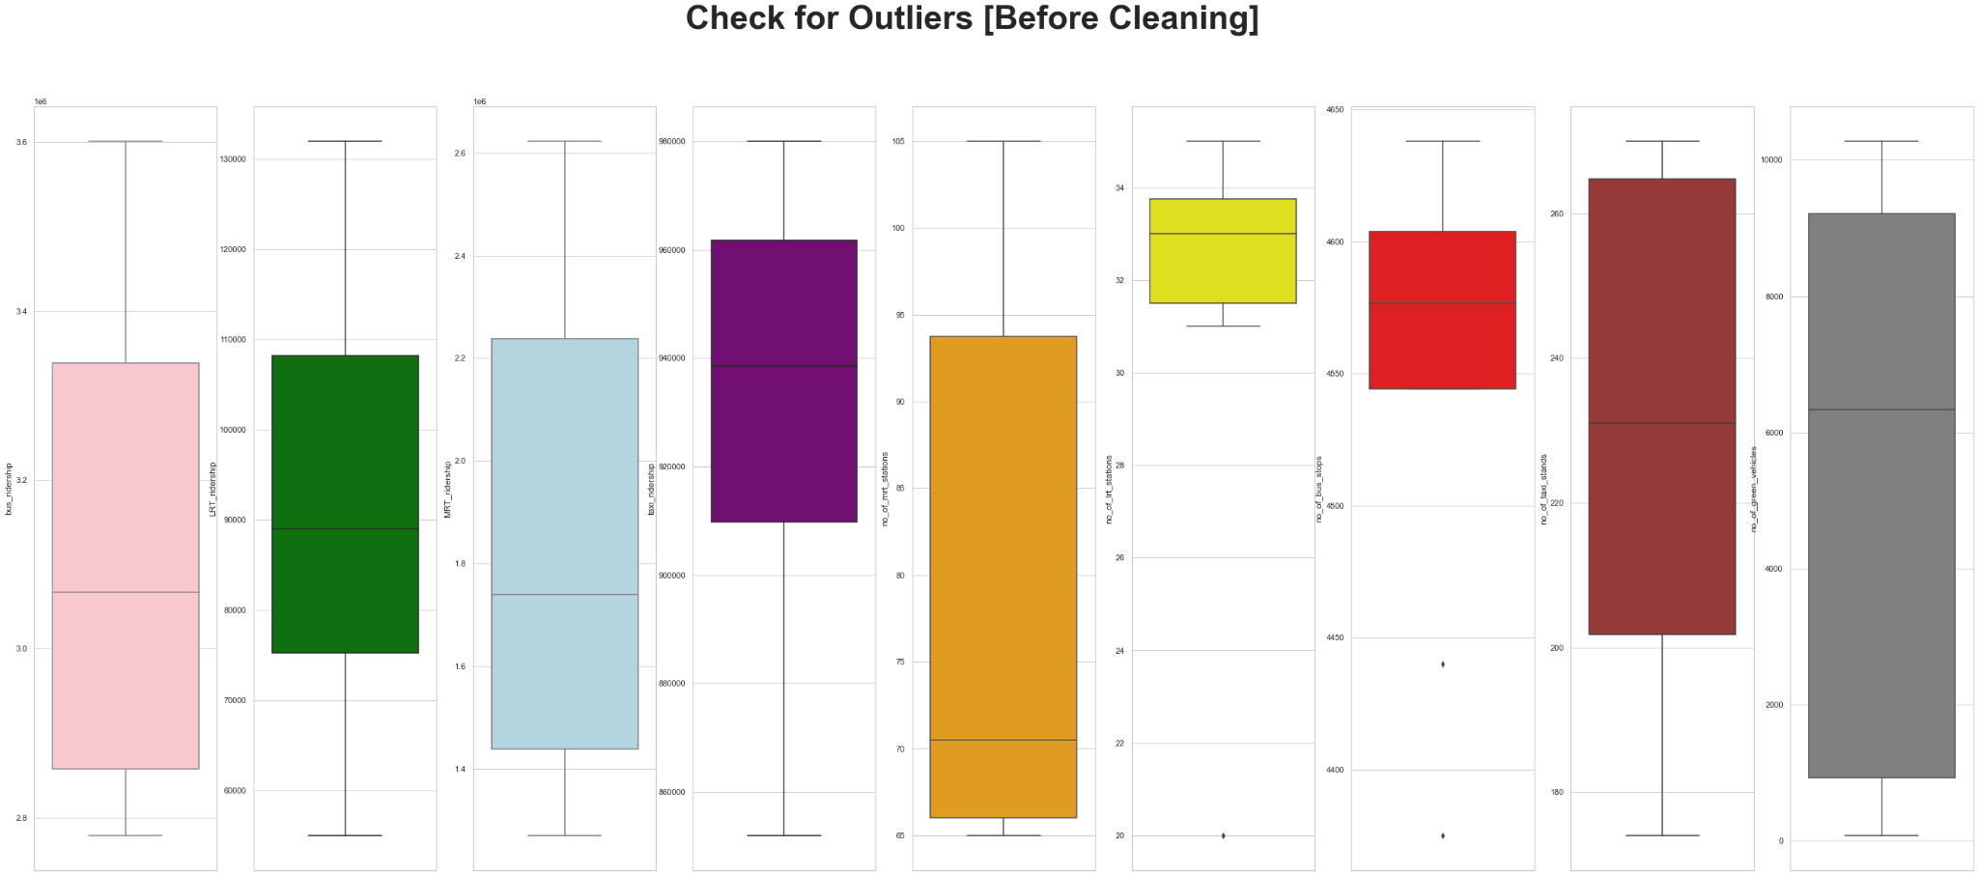
Identify & Handle Outliers
I plotted box plots to show for presence of outliers in the dataframe.
It shows that there are presence of outliers in the columns ‘no_of_lrt_stations’ and ‘no_of_bus_stops’.

Slide 17
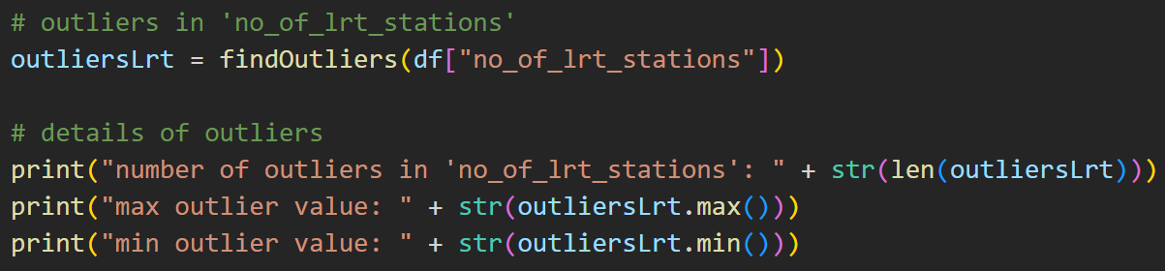
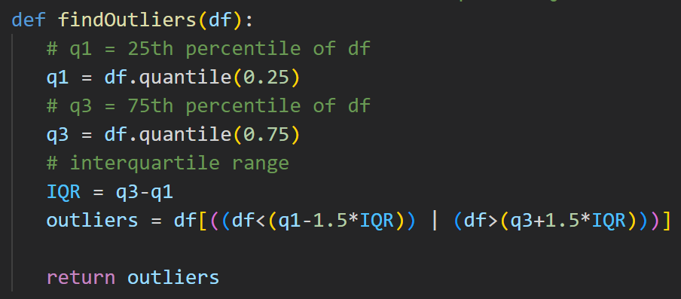
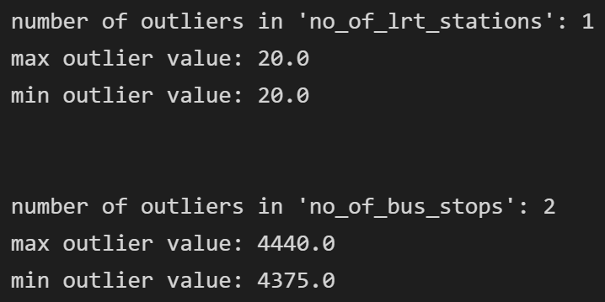
Identify & Handle Outliers
I created a function to find out the number of outliers, minimum value, and maximum value of outliers in the dataframe.
This helped me to easily replace the outliers.

Slide 18
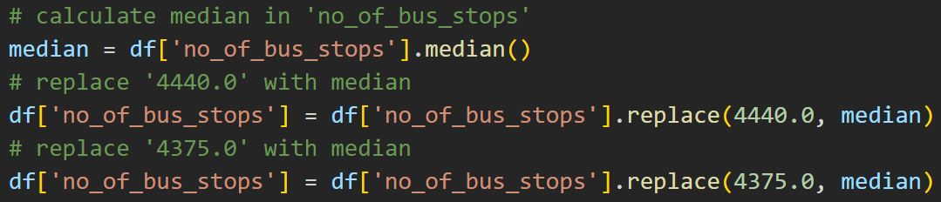
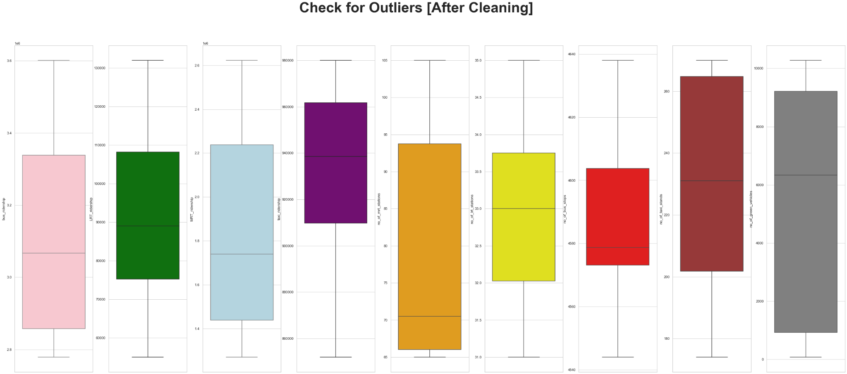
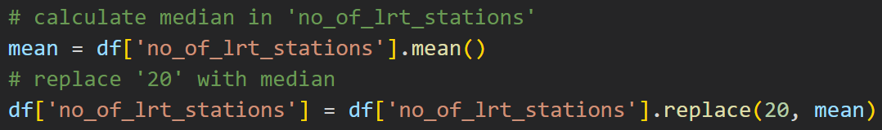
Identify & Handle Outliers
I handled outliers in ‘no_of_lrt_stations’ by replacing them with the mean as it has a normal distribution.
I handled outliers in ‘no_of_bus_stops’ by replacing them with the median as it has a skewed distribution.

Slide 19
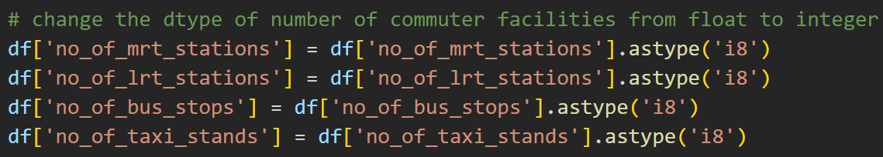
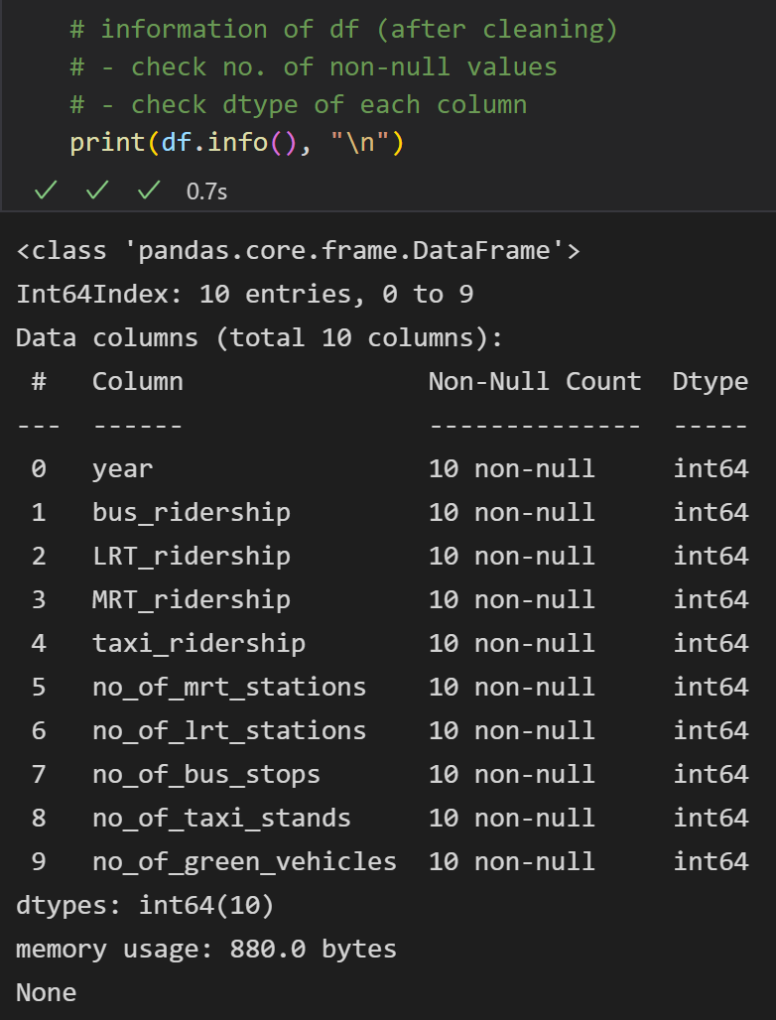
DATA TYPE/ INFO OF DF
I changed the dtypes as number of facilities should be a whole number and not a float.
The final information of dataframe shows that there are no null/missing values, with renamed columns and changed data types to help in my data analysis!

Slide 20
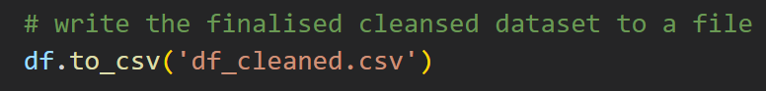
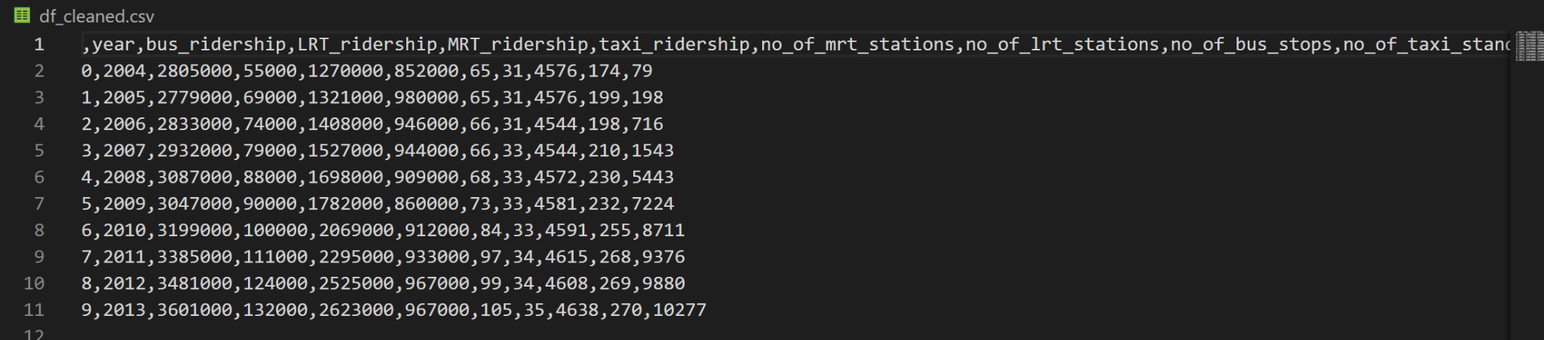
Write finalised cleansed dataset to a file

Slide 21
03
DATA ANALYSIS

Slide 22
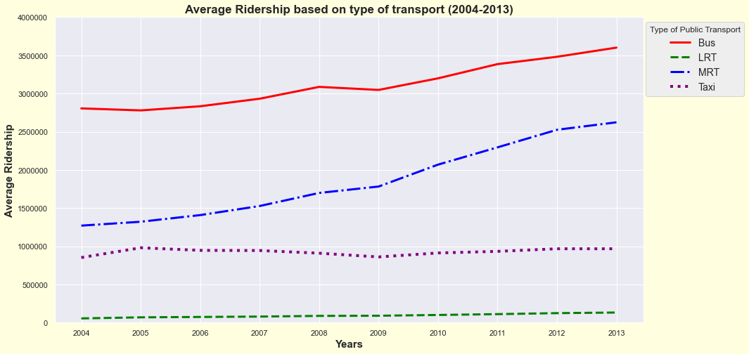
Objective 1:
Do Singaporeans choose to take public over private transport?
I have used seaborn to plot line plots to show the average ridership of the types of public transport over the years.
Buses have the highest average ridership while LRT has the lowest average ridership.
The average ridership of buses and MRT are significantly greater than taxis, and seen to have a smooth increasing trend, whereas the trend for taxis show slight fluctuations and insignificant increase in ridership.
LRT shows slight increase in ridership over the years.

Slide 23
—INSIGHTS GAINED
From the line chart analysis, I can conclude that Singaporeans have indeed utilise public transport (bus, mrt) more than private transport (taxis).
LRT might have the lowest average ridership due to the fact that people rarely use LRT as they carry a smaller number of people as compared to MRT and buses, or people do not commute much to places with LRT.

Slide 24
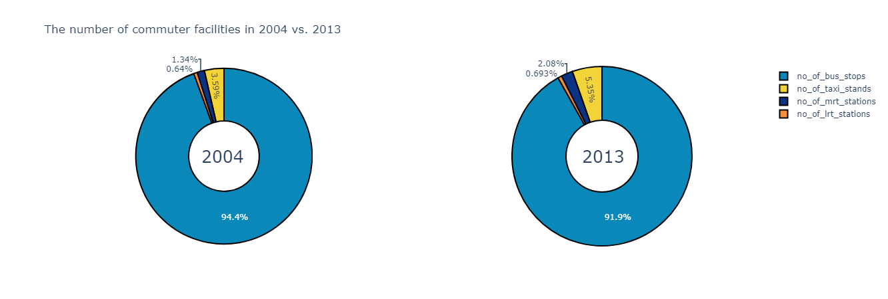
Objective 2:
Has Singapore made public transport more accessible as compared to private?
I created the pie charts with plotly.
It is seen that the number of bus stops is the greatest among the other commuter facilities in the past and present, while the number of LRT stations has always been the least.
The number of taxi stands is the second largest after bus stops.

Slide 25
—INSIGHTS GAINED
From the pie charts, it is evident that accessibility towards public transport is lacking in some ways, where there are insufficient facilities as compared to taxi stands (private transport).
The large number of bus stops may heavily encourage people to take buses more as bus stops can be easily found, bringing convenience to their lives.
Although MRT and LRT facilities are way lesser than taxi facilities, it does not mean that public transport is less accessible. As not only is public transport a cheaper option, but it also prevents the problem of traffic jams.

Slide 26
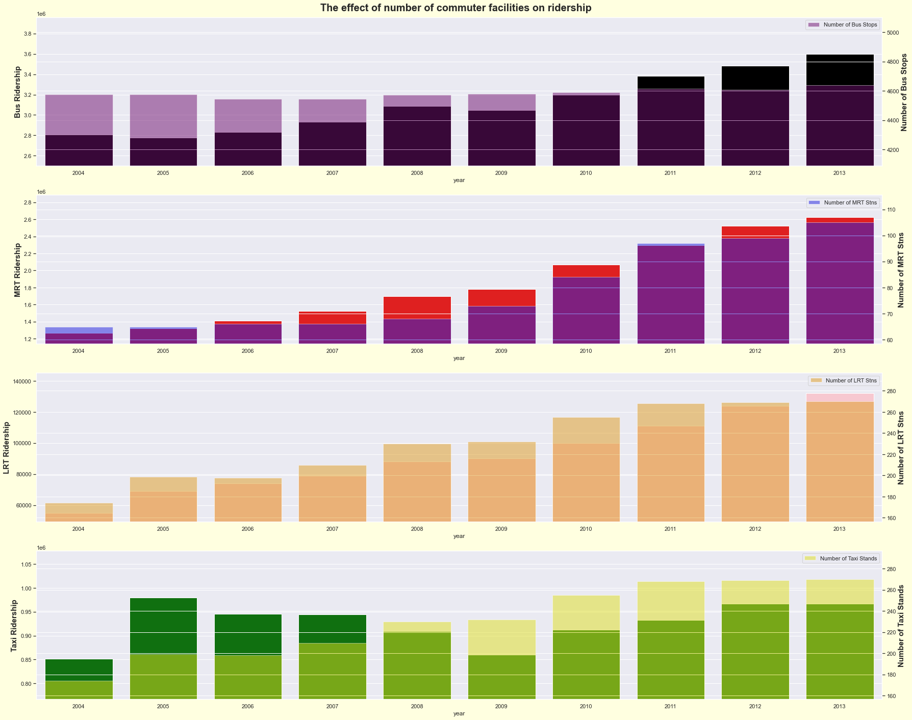
Objective 3:
How has accessibility to commuter facilities influence people’s transport choices?
All the graphs show a positive relationship that as the number of commuter facilities increases, the average ridership for each type of transport also increases.
This suggests that accessibility to commuter facilities do indeed influence people’s transport choices, as more facilities means that people can easily find bus stops, taxi stands, etc. to travel from one destination to another.

Slide 27
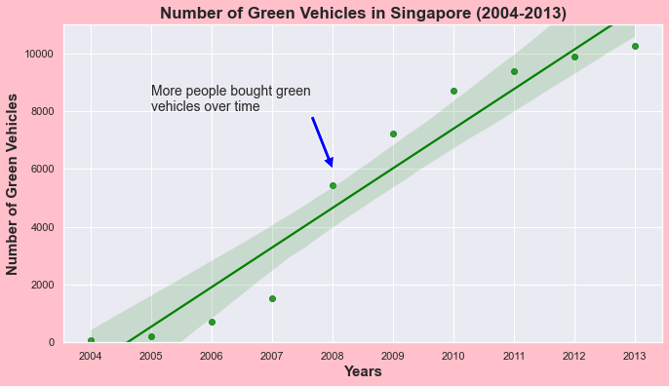
Objective 4:
Has Singaporeans choose to buy eco-friendly cars over fuel-run cars?
I created a regplot using seaborn.
The regression line shows a positive correlation between the number of years and number of green vehicles.
The scatter points are moderately clustered around the regression line, indicating a moderate and positive correlation.
The confidence interval (shaded area) is narrow and close to line, predicting a high certainty that the number of green vehicles in Singapore will continue to increase over the years, suggesting that Singaporeans have taken steps to help the environment by choosing cleaner transport options that do not emit harmful gases to the atmosphere.

Slide 28
04
FINAL INSIGHTS

Slide 29
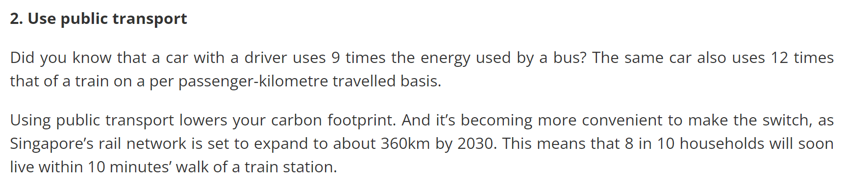
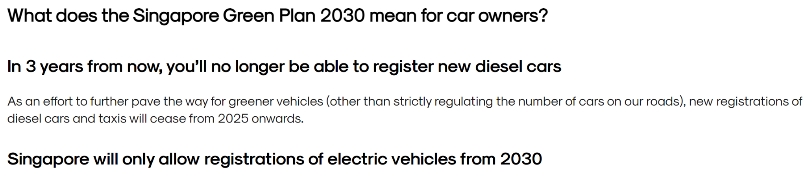
Source: https://www.gov.sg/article/how-to-make-your-commute-a-more-sustainable-one
Source:
https://getgo.sg/blog/singapore-green-plan-2030-what-does-it-mean-for-car-owners/
As such, Singapore has indeed taken steps to help environmental issues by building and providing public transport facilities to the public, as well as choosing to buy cars that are more eco-friendly.
I hope that with the help of media and Singapore Green Plan 2030, Singapore will continue to find more ways to save the environment, such as building more MRT and LRT stations!

Slide 30
THANK
YOU
Please keep this slide for attribution

